Slide 1

EN.580.428 Genomic Data Visualization Lesson 1 Spatially Resolved Transcriptomics Data
Prof. Jean Fan

Slide 2
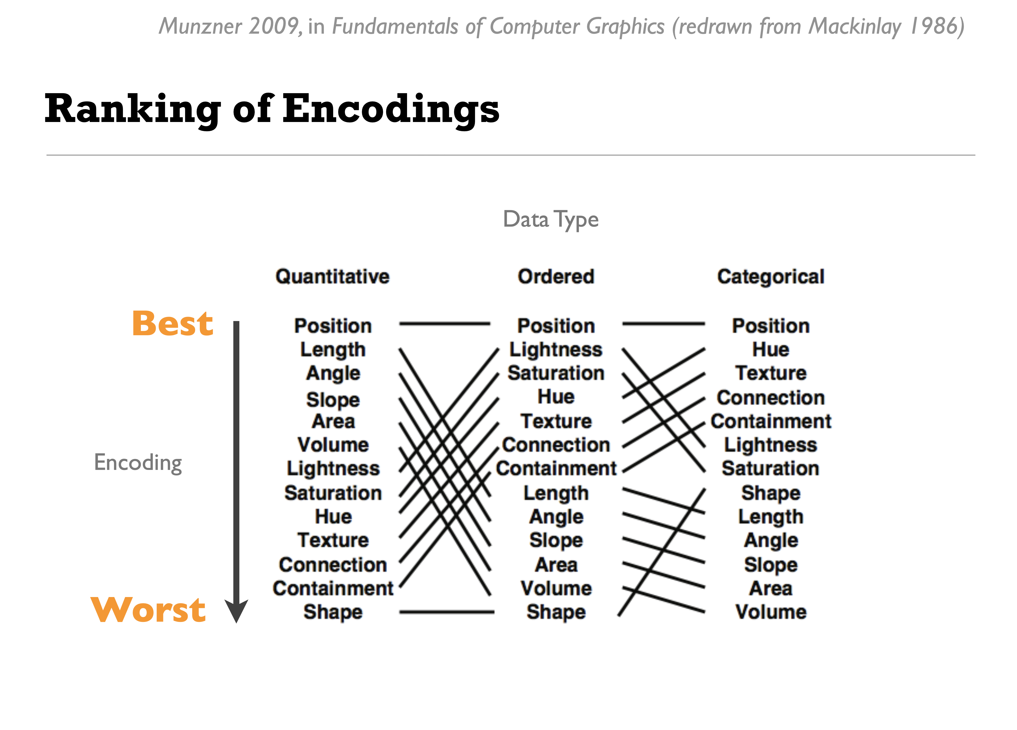
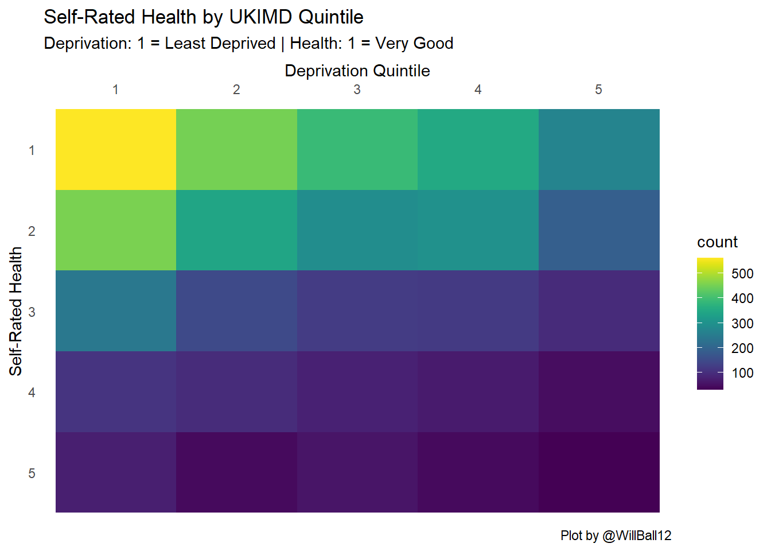
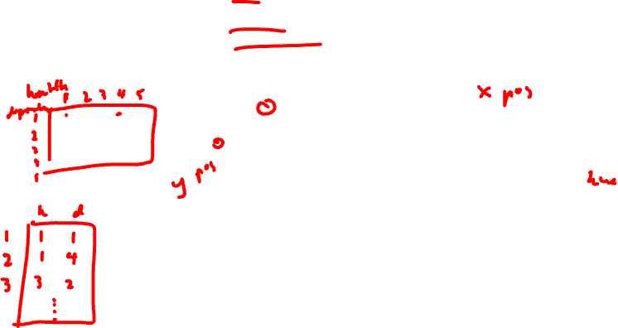
health: ordinal data, from 1 = Very Good to 5 = Very Poor
deprivation: ordinal data, ordered from 1 = Least Deprived to 5 = Most Deprived
frequency of an observation: quantitative counts

Slide 3
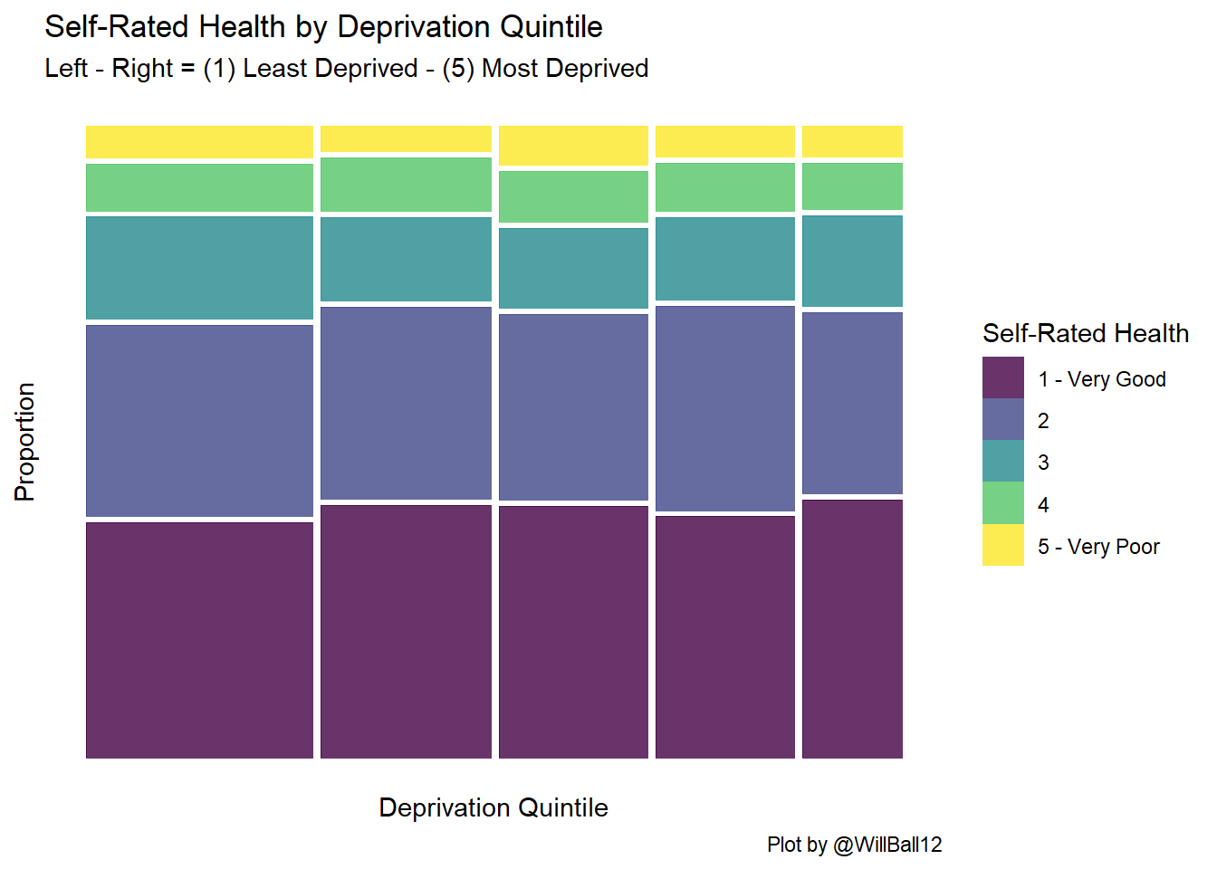
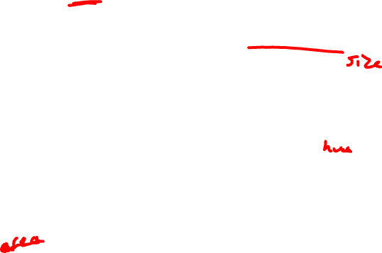
health: ordinal data, from 1 = Very Good to 5 = Very Poor
deprivation: ordinal data, ordered from 1 = Least Deprived to 5 = Most Deprived
frequency of an observation: quantitative counts

Slide 4
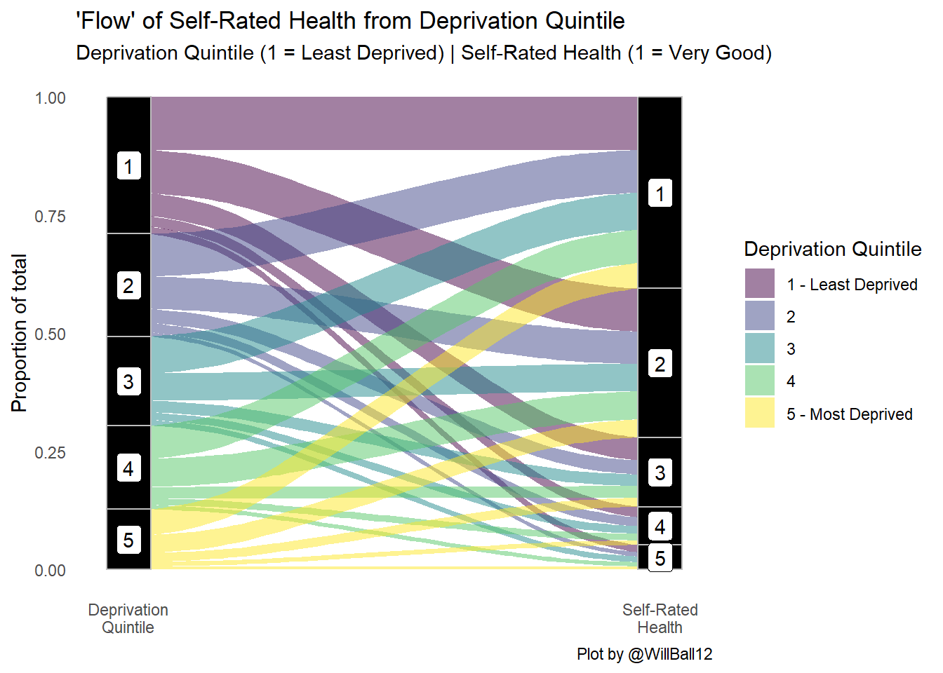
health: ordinal data, from 1 = Very Good to 5 = Very Poor
deprivation: ordinal data, ordered from 1 = Least Deprived to 5 = Most Deprived
frequency of an observation: quantitative counts

Slide 5
Lesson learning objectives
understand what is spatially resolved transcriptomic data
different kinds of spatial transcriptomics technologies
how the data is generated
begin visualizing and interacting with the data
assign HW datasets

Slide 6
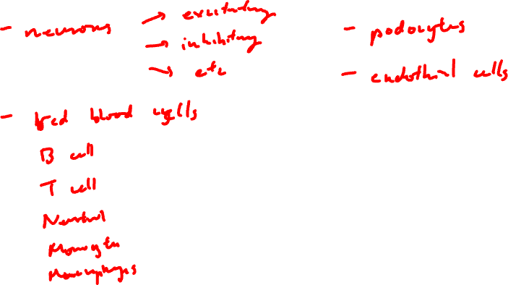
What are some different cell-types?

Slide 7
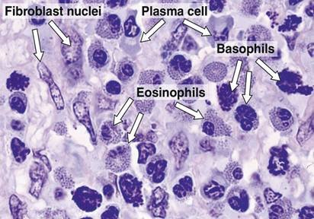
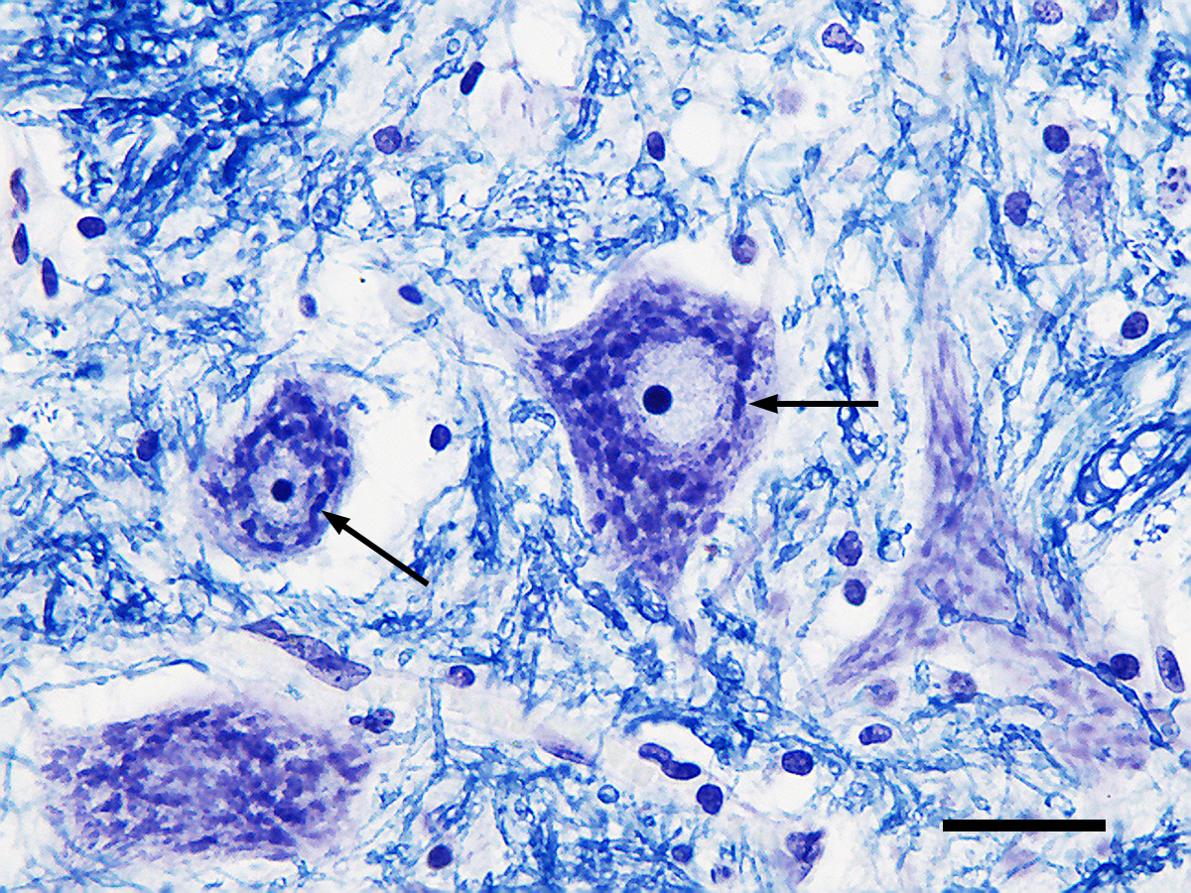
What are some different cell-types?
H&E
Nissl
(Source: Wikipedia)

Slide 8
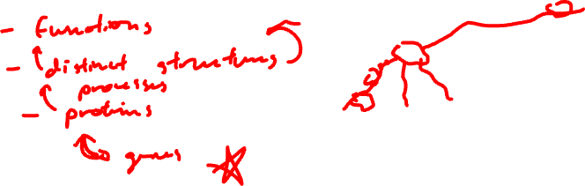
How can we distinguish these cell-types (and cell-states) from each other?

Slide 9
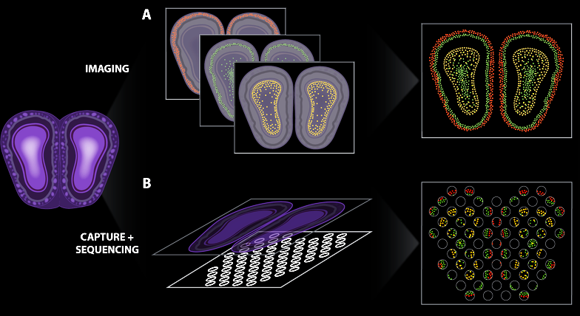

Spatially resolved transcriptomic technologies enable us to profile what genes are expressed by cells in tissues
(Atta and Fan, Nature Communications, Sept 2021)
Notes:
different technologies
vary in terms of throughput, sensitivity, resolution
statistical analysis methods will be different
7

Slide 10
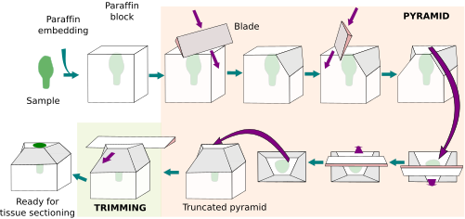

You’re working with 15um thin sections of tissue

Slide 11
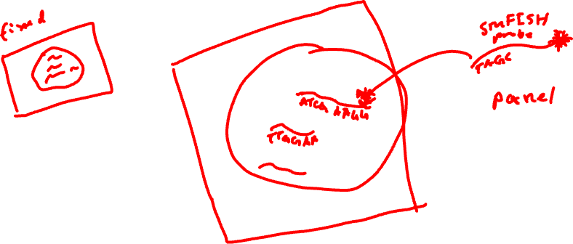
Low-throughput imaging-based spatial transcriptomic profiling techniques: single molecule fluorescence in situ hybridization

Slide 12
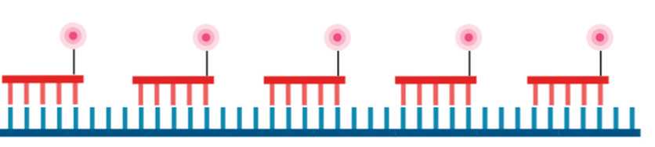

Question: I design 5 smFISH probes to target the same gene. How many spots will I see when I take a picture? (hint: how far apart are these spots assuming one base pair corresponds to 3.4 Å or 0.34 nanometers)

Slide 13
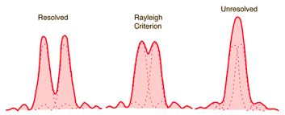
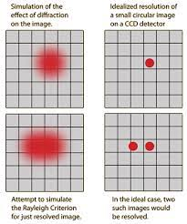

Recall: diffraction limit
1D
2D
diffraction limit for a microscope ~ 250nm

Slide 14
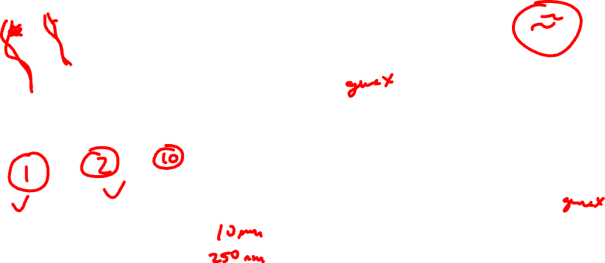
Question: I design 5 smFISH probes to target the same gene. How many spots will I see when I take a picture?

Slide 15
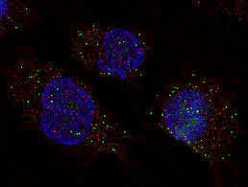
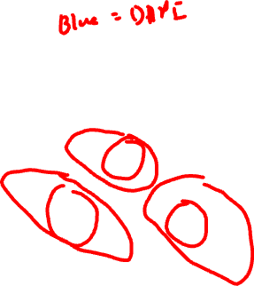
smFISH enables imaging of single mRNA molecules
Fluorophore
Oligonucleotide
gene1
gene2
gene3
(Femino et al., Science, 1998)
(Raj et al., Nature Methods, 2008)
(Lukumbuzya et al., Front. Microbiol, 2019)

Slide 16
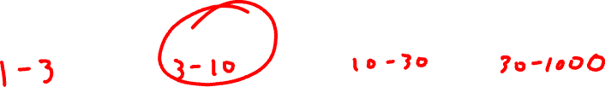
How many genes can we image simultaneously with smFISH? (hint: how many colors we can visually distinguish?)

Slide 17
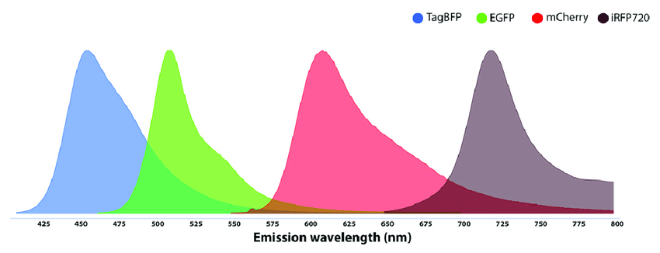

Recall: Spectral overlap
Spectral overlap

Slide 18
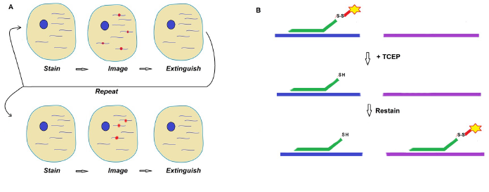

Sequential smFISH

Slide 19

Sequential smFISH
Practice
Consider I am imaging 1 fluorescence probe color. I can do 10 rounds of imaging.
Using sequential smFISH, how many different gene species can I detect?

Slide 20
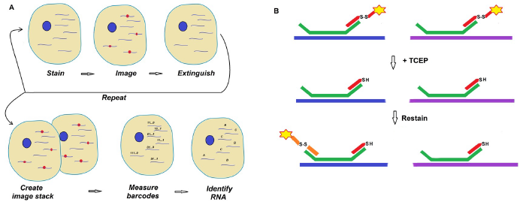
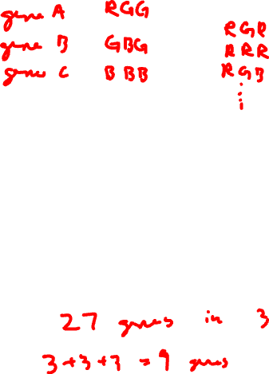
Multiplexed smFISH

Slide 21
Sequential vs multiplexed smFISH
Practice
Consider I am imaging 1 fluorescence probe color. I can do 10 rounds of imaging.
Using multiplexed smFISH, how many different gene species can I detect? (recall combinatorics)

Slide 22
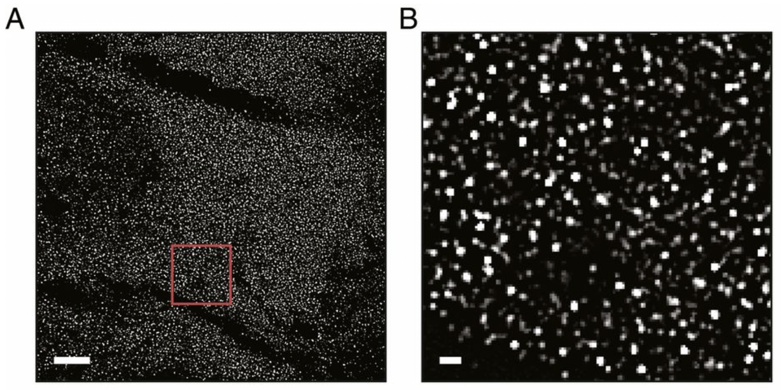
(Xia*, Fan*, Emanuel*, et al PNAS 2019)

Slide 23
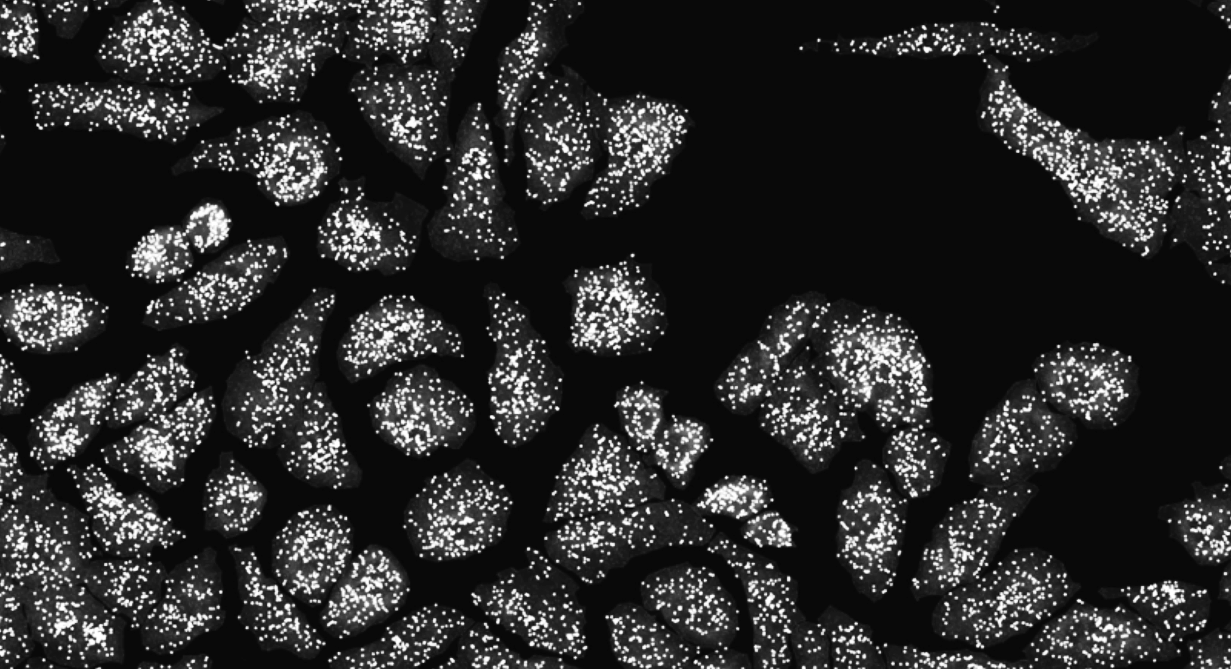
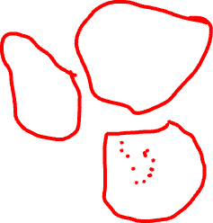

Slide 24
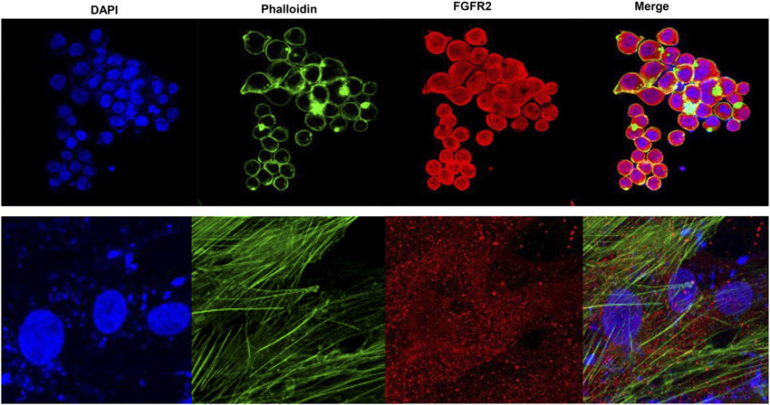
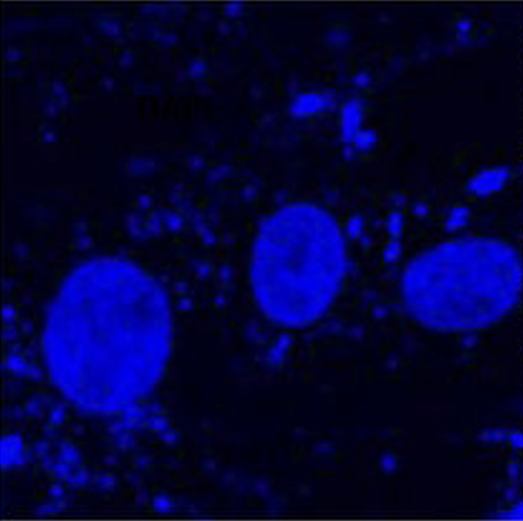
Water-shedding dapi-based cell segmentation

Slide 25
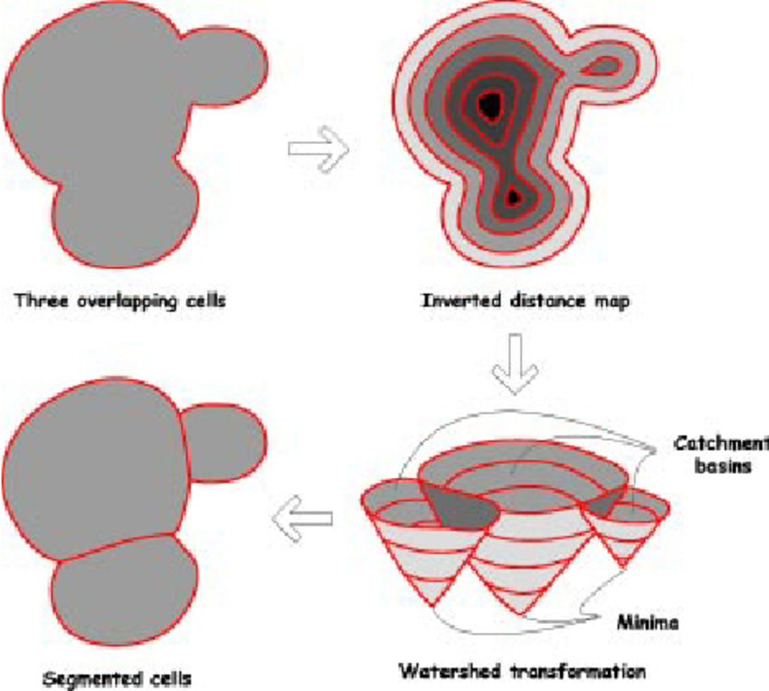
Water-shedding dapi-based cell segmentation

Slide 26
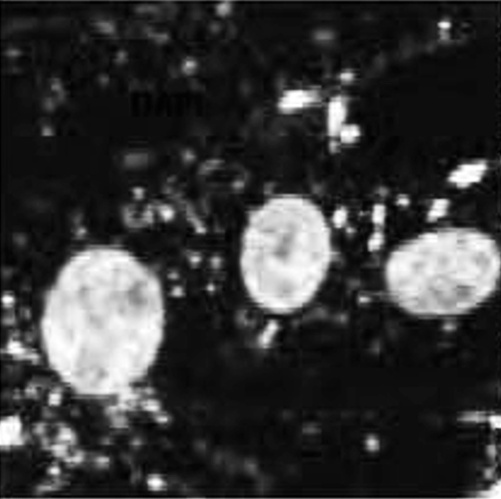
Water-shedding dapi-based cell segmentation

Slide 27
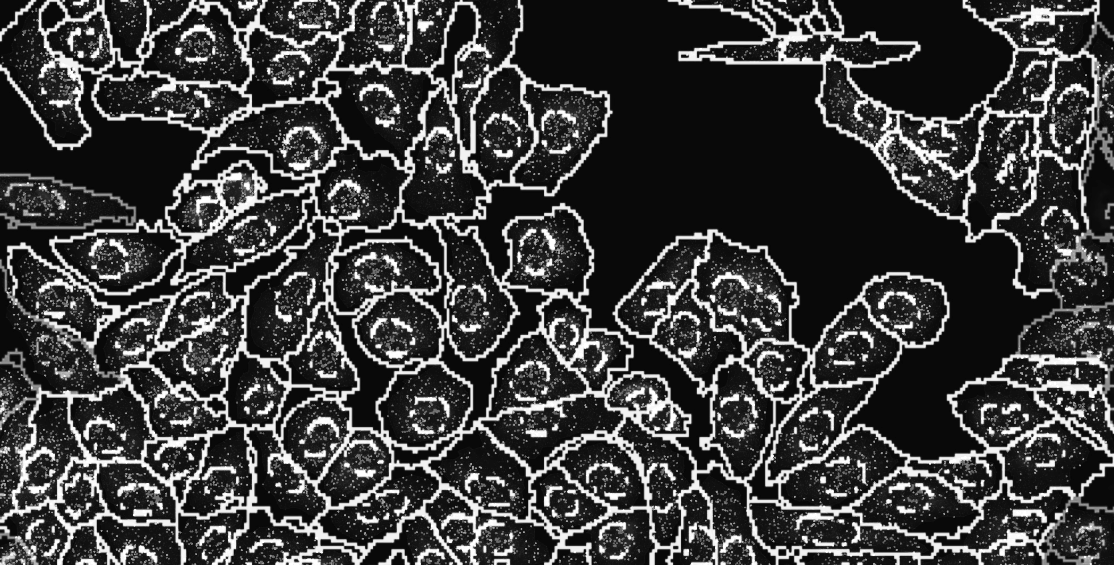
Notes:
and count how many copies of each gene we detect in each cell

Slide 28
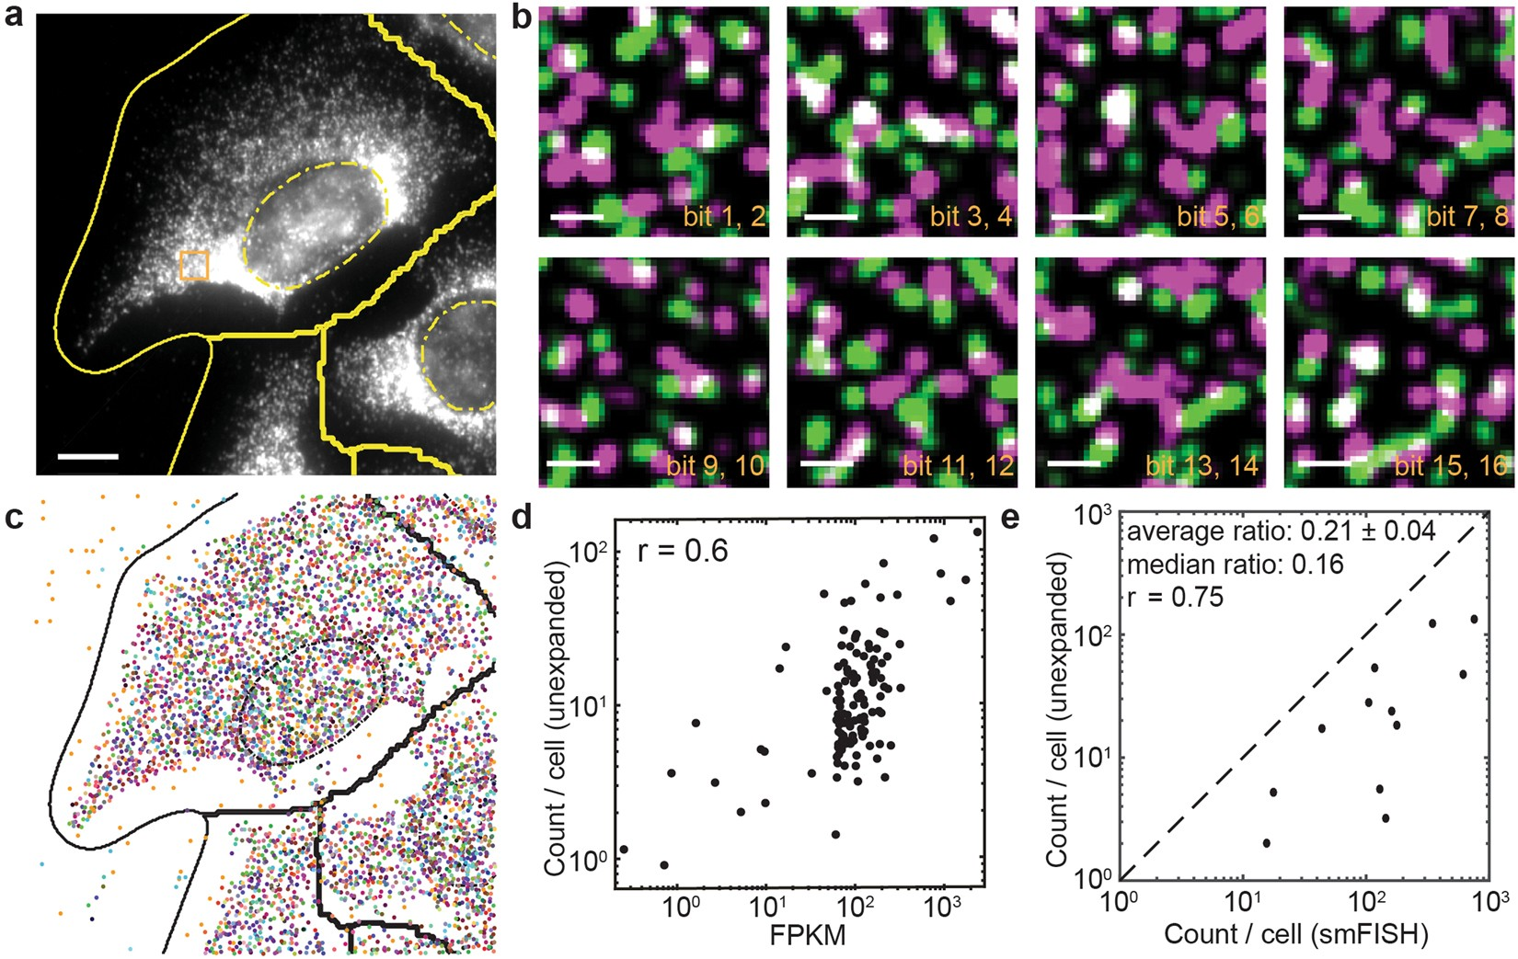
Cell segmentation + spot detection + gene counting within cells = cell x gene count matrix

Slide 29
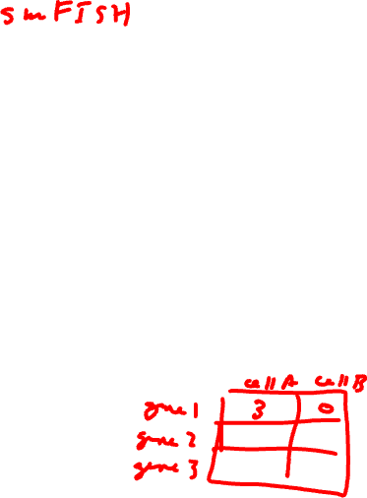
Practice
Fluorophore
Oligonucleotide
gene1
Cell B
gene2
gene3
Cell A
Convert to count matrix →

Slide 30
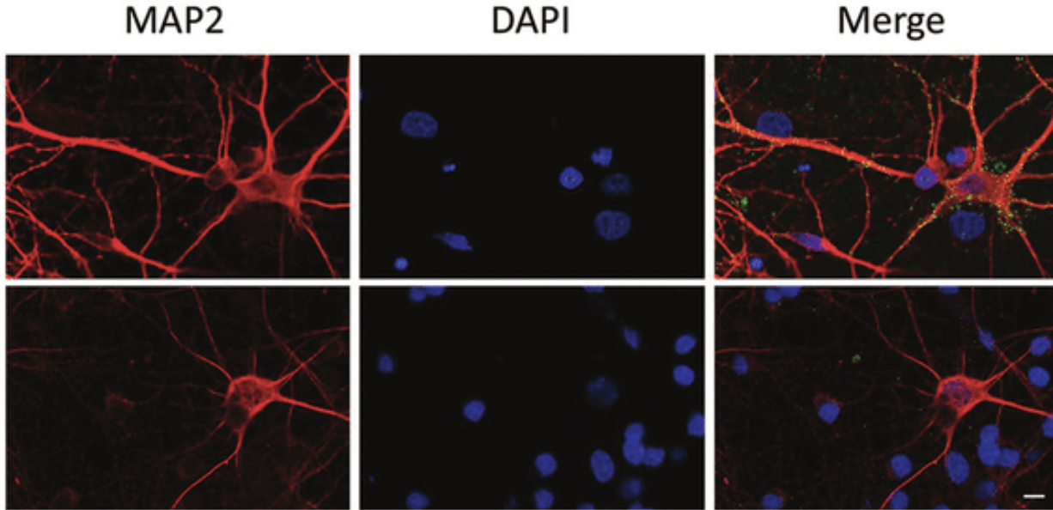
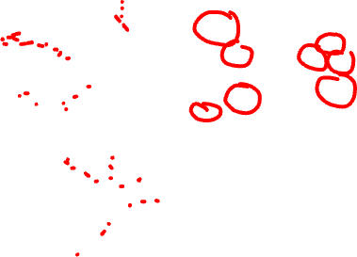
What if you have a cell like a neuron with axon and dendrites?
Practice

Slide 31
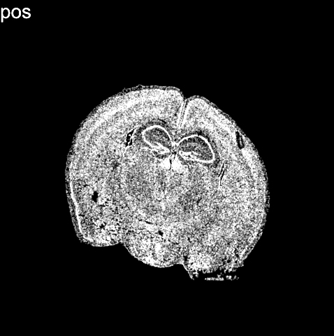
(Vizgen data)
Notes:
What we end up with is not only an image of where cells are within fixed tissues (here we have a cortical section of the mouse cortex)

Slide 32
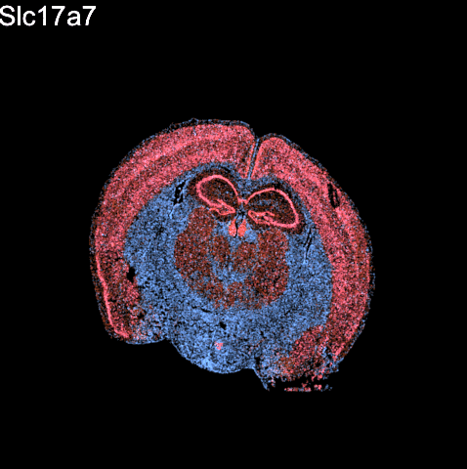
(Vizgen data)
Notes:
But we can see how targeted sets of genes are expressed within these cells within the tissues

Slide 33
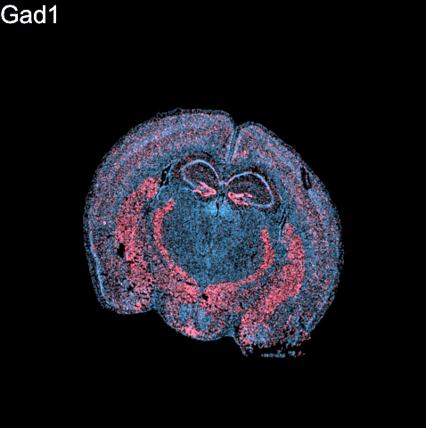
(Vizgen data)
Notes:
But we can see how targeted sets of genes are expressed within these cells within the tissues
For 100s to 1000s genes

Slide 34
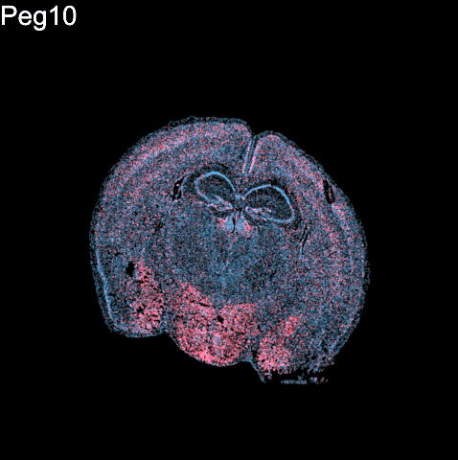
(Vizgen data)
Notes:
But we can see how targeted sets of genes are expressed within these cells within the tissues
For 100s to 1000s genes

Slide 35
Questions before we move onto sequencing-based spatial transcriptomics?

Slide 36
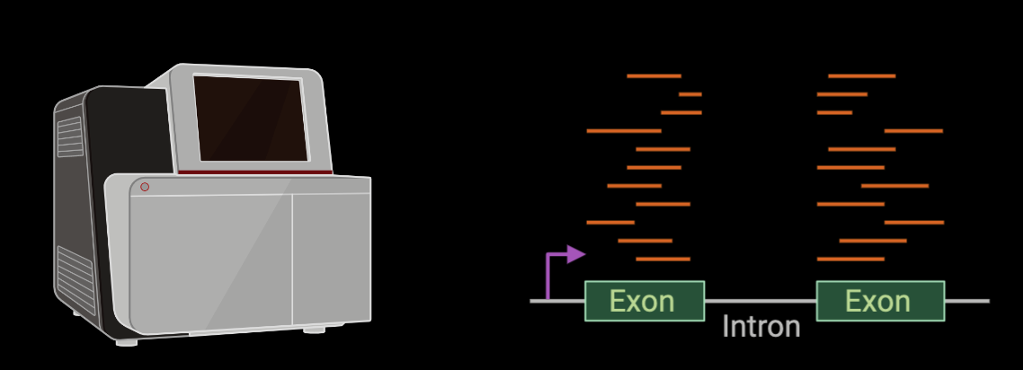
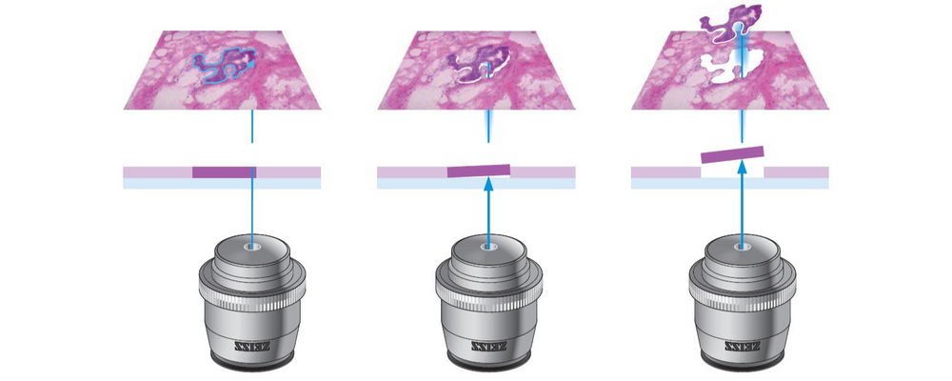

Low-throughput sequencing-based spatial transcriptomic profiling techniques: micro-dissection

Slide 37
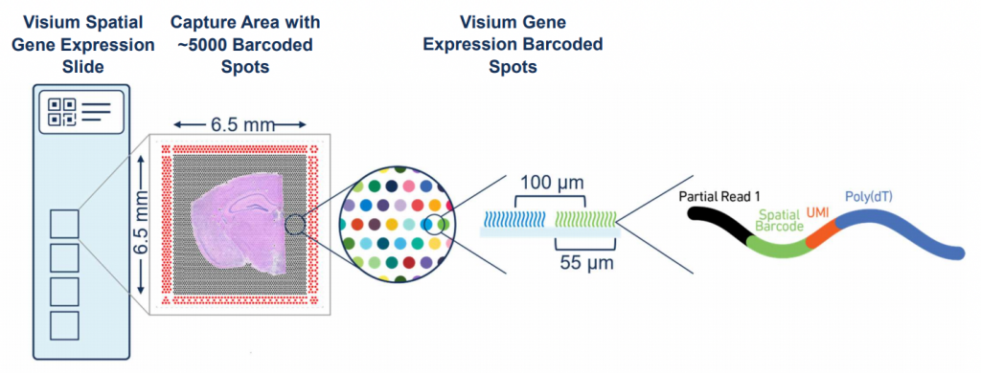
Spatial-barcode bead capture

Slide 38


Recall: mRNAs have poly(A)-tails

Slide 39
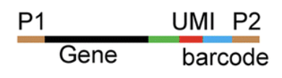
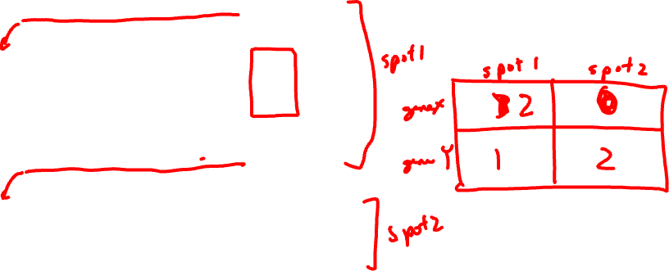
What our data looks like
Practice
spatial
barcode
gene
UMI
ATCGGATCGTATAAATGCGTAGCTAGTC----AATG----AGTT
Convert to count matrix →
Gene X
ATCGGATCGTATAAATGCGTAGCTAGTC----TTTG----AGTT
ATCGGATCGTATAAATGCGTAGCTAGTC----TTTG----AGTT
TTGAGTATATGATGAAGATGAAAGGAT----AGGT----AGTT
Gene Y
TTGAGTATATGATGAAGATGAAAGGAT----ATTG----GTAA
TTGAGTATATGATGAAGATGAAAGGAT----GATA----GTAA
…
…

Slide 40
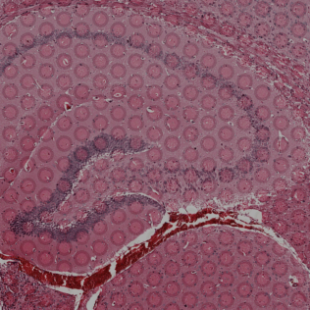
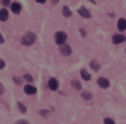
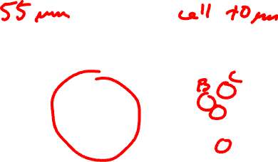
What happens if you have multiple cells in the same spatial spot?
Practice

Slide 41
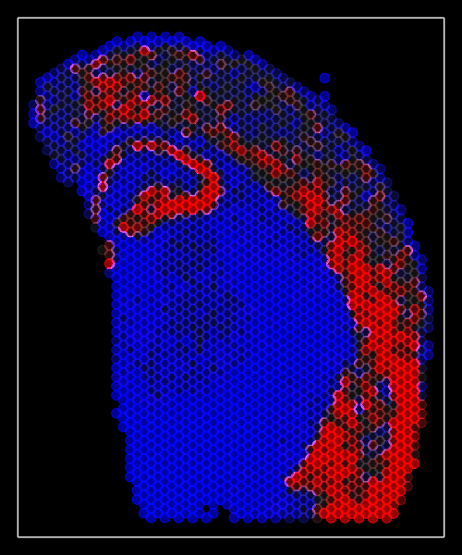
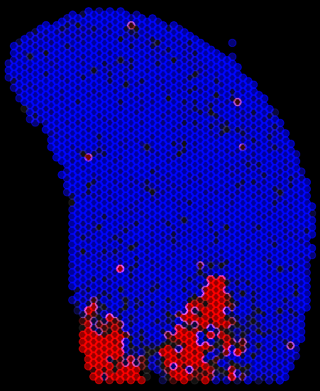
Spatial-barcode bead capture
Slc17a7
Peg10
…

Slide 42
Questions before we move analyzing our own spatial transcriptomics datasets?

Slide 43

What are the pros and cons of each spatial transcriptomic approach?
Practice

Slide 44



begin your adventure with your starter pokemon dataset
Imaging-Based
Sequencing-Based
Xenium-IRI-ShamR_matrix.csv.gz
Visium-IRI-ShamR_matrix.csv.gz

Slide 45

HW1

Slide 46


If you want to learn more, original scientific papers are available on class website

Slide 47

Hands-on Component: Getting started with R and R-Studio
https://posit.co/download/rstudio-desktop/

Slide 48
Reflection Cards on Canvas

